Slide 1
Fracture
Dr AbdEl-haleem H. Elkasapy, Ph.D
Lecturer of surgery &Anesthesiology and Radiology
Faculty of veterinary Medicine Benha university

Slide 2
Internal fixation of fracture
Means fixation of the fracture fragment itself after surgical exposure of the fractured area using metal in a special manner.
Properties required of fixation materials:
1- the material should has suitable mechanical properties to fill fixation and maintenance of reduction.
2- not corrosive
3-not release harmful by products locally or systemically

Slide 3
Materials used:
Stainless steel
Titanium
Others (nickle in addition to cobalt, chromium, molybedenum.

Slide 4
Advantages of internal fixation
Anatomic reduction of the fragment
Preservation of blood supply to bone fragment
Stable fixation
Free immobilization of the muscle and joints
Disadvantages of internal fixation:
Fear of infection
High cost
Need experience

Slide 5
Pin screw (lag screw-bone screw)
There are two types:
Cortical
Cancellous
Indications:
Used for fixation of epiphyseal or condular fractures
Fixation of oblique or diaphyseal fracture

Slide 6
Pin screw
Procedures of application:
Control animal and anesthesia
Aseptic preparation
Osteotomy for exposure of the fractured area
Reduction of the fracture
A hole is drilled to accommodate bone screw
The screw inserted along the detached piece and the main bone.

Slide 7
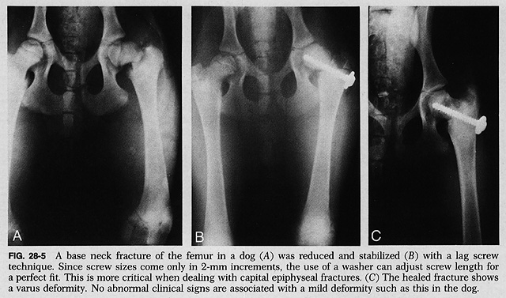
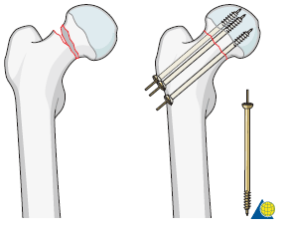
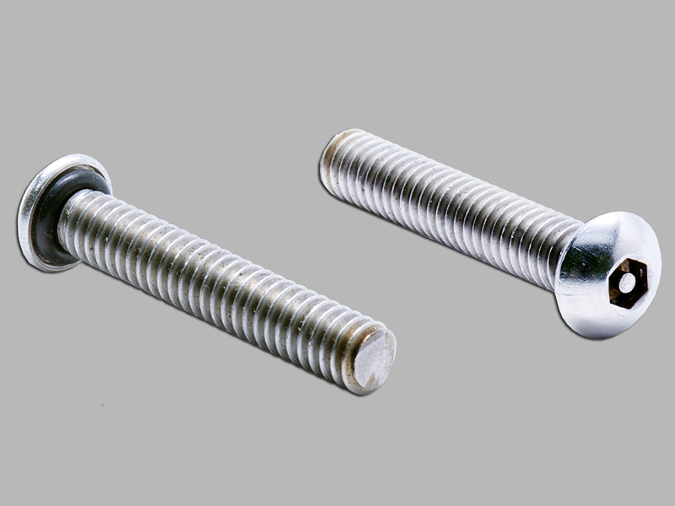
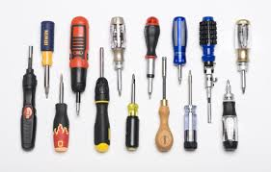

Slide 8
Bone plates
Ideal for long bone fractures and adapted to all types of fractures.
Different designs & hole types of plates available
It is important to choose a plate of correct length and type.
Straight plates& semitubular plates are the most common used.
Types of plates
Compression plates
Neutralization plates
Buttress plates

Slide 9
Bone plates
Provide rigid internal fixation
Disadvantages:
Direct exposure of the plate on the bone
Need large incision till exposure of bone
Application:
Control &anesthesia
Aseptic preparation – surgical interference
The plate placed on the lateral aspect of bone
2 or 3 pins should be placed on each segment
It is preferable to remove the plates after healing

Slide 10
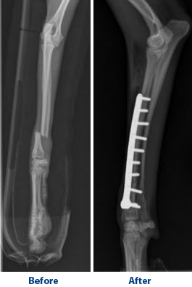
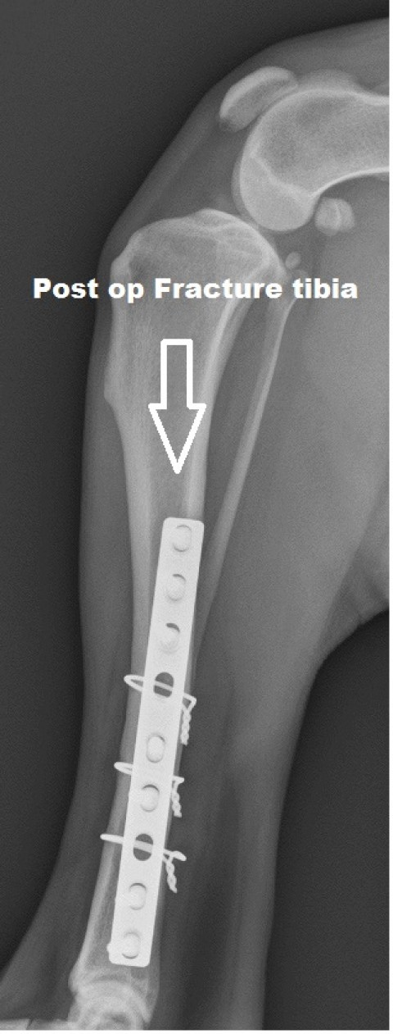
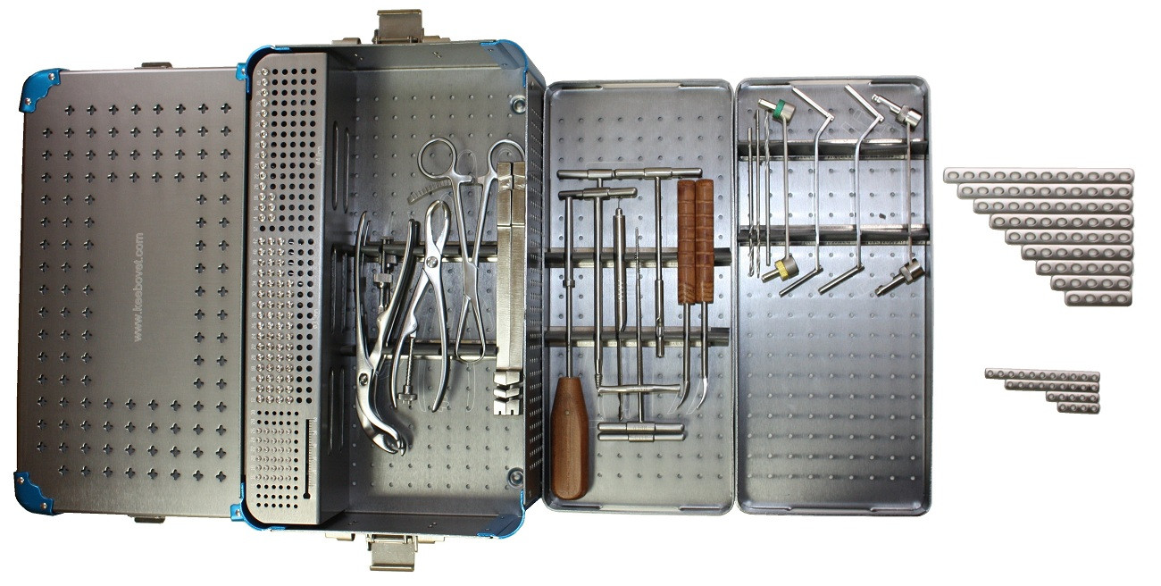

Slide 12
Bone wiring (circlage or hemicirculage wire)
Wire used alone or with other method of internal fixation
Use stainless steel wire 18-20 gauge in dogs
The wire applied on the oblique or comminuted fracture and tightened twisted and commonly accompanied internal fixation

Slide 13
Bone suturing
Indicated in case of fracture of the long bone
The bone is drilled firstly for passing of wire
The two fractured bone are sutured and then the wire was tightly twisted

Slide 14
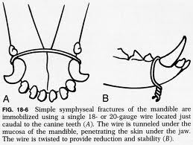
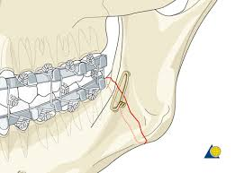
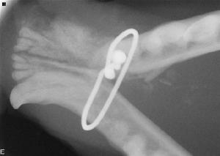
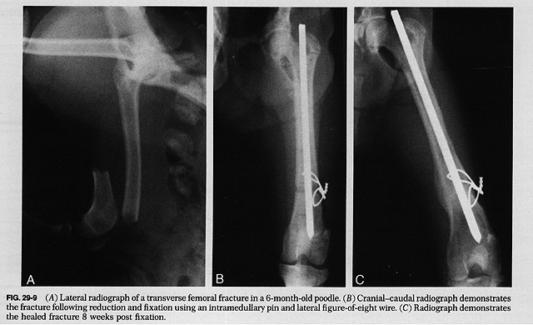

Slide 15
Intramedullary fixation
The most used system of internal fixation in veterinary practice
The most used steninann pin, rush pin, kurshnerpin
Used in fracture of long bones mostly middle third

Slide 16
Application Intramedullary pin
Anesthesia &surgical preparation
Open reduction of the fractured bone
The pin is inserted at the fracture site till appear from the bone
The two pieces reduced to their site then the pin is pushed by drill in retrograde manner
The protruded part of the pin removed by bone cutter under level of skin

Slide 17
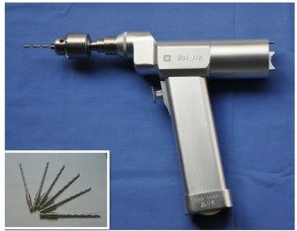
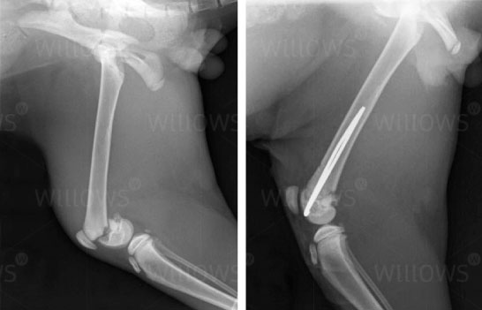
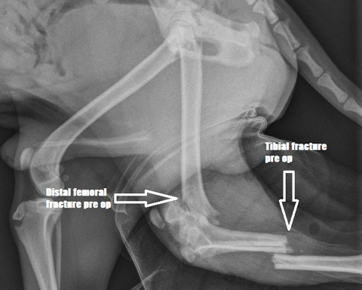
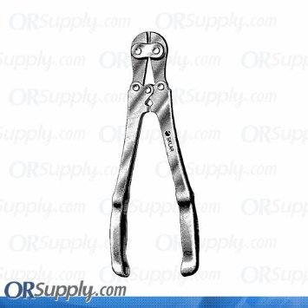
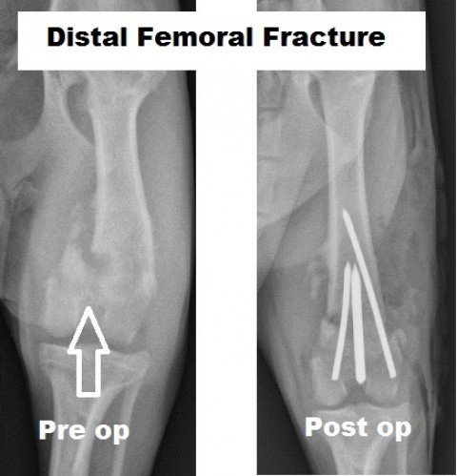
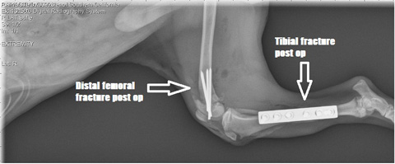

Slide 19
Bone grafting
It is living tissue that is transplanted to another site within the same animal or another to repair a defect
Bone grafting may be:
Autograft: within the same individual
Allograft: from one to another of the same species
Xenograft : from one to another of a different species

Slide 20
Bone graft may be:
Cancellous bone graft: indicated at area need rapid bone formation, mainly autograft
Used in highly comminuted fracture
Harvesting site:- greater tubercle of humerus
Tuber ischii, ilium and medial condyle of tibia
Cortical bone graft: mainly allograft
Used for replacement of large segmental bone defects
Used from another donor and fixed by plate

Slide 21
Treatment of compound fracture
Treatment of wound
Prevent extension of infection
Treatment of fracture
Remove m.o, remove foreign materials, devitalized tissues, local dressing of wound
Local and systemic antibiotic
Fracture fixation by
- internal fixation
- external cast with window

Slide 22
Complications of fracture healing
1- complication due to prolonged immobilization (joint stiffness, muscle atrophy)
2- complication from fractured end ( nerve and blood vessels injury)
3-complications from improper treatment

Slide 23
1-Delayed union: due to
Imperfect apposition
Interposition of soft tissue
Impairment of blood supply
Infection of the bone
Senility
Reaction of plates and screws
Diagnosed by radiography and showing:
No healing
The fractured gap will be filled with granulation tiisue not scar tissue
Increase cavity and gap between bones

Slide 24
2-Non union:- leading to false joint
Diagnosed by:
Lack of rigidity with bowing of bone
Callus formation almost absent
Obvious pain at the fracture site
Failure to use limb
Atrophy of muscles
Large gap between fractured ends
Treatment
Bone grafting
Internal fixation

Slide 25
3-Large callus formation:
Occur due to improper reduction
4-faulty callus formation:
Callus formed but calcium not sufficient due to some diseases as rickets or osteomalcia
5-formation of a false joint
Due to pass of soft tissue band between two ends
Ttt by remove tissue refresh two ends and unit them by suture or plates
6- joint stiffness: due to joint immoblization
7-gangrene formation
Due to tightly applied cast which press on blood supply on the area leading to gangrene

Slide 26
Abdelhaleem Elkasapy

